Slide 1

AIRBNB DATA ANALYSIS
By- S.BOPCHE

Slide 2
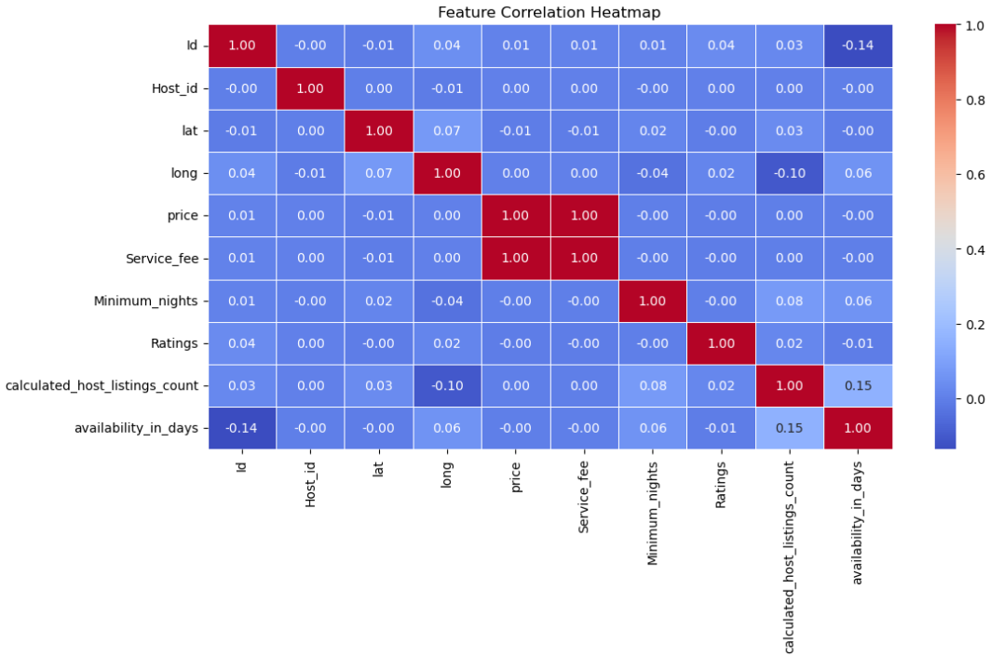
Showing Correlation Using Heatmap Visualization
Key Insights from Correlation Heatmap :
Weak Correlations:
Most features have weak or no correlation with each other, as shown by the predominantly blue color. This suggests limited linear relationships in the data.
Price and Service Fee:
There is a strong positive correlation (1.0) between Price and Service Fee, which is expected since service fees are often a percentage of the price.
Availability and Host Listings:
A positive correlation (0.15) between calculated host listings count and availability in days indicates that hosts with multiple listings tend to keep properties available for longer durations.
Availability and ID:
A slight negative correlation (-0.14) between Availability in Days and ID suggests newer listings might have lower availability.
Ratings and Other Variables:
Ratings show no strong correlation with price, service fee, or availability, implying that factors other than these variables influence guest satisfaction.

Slide 3
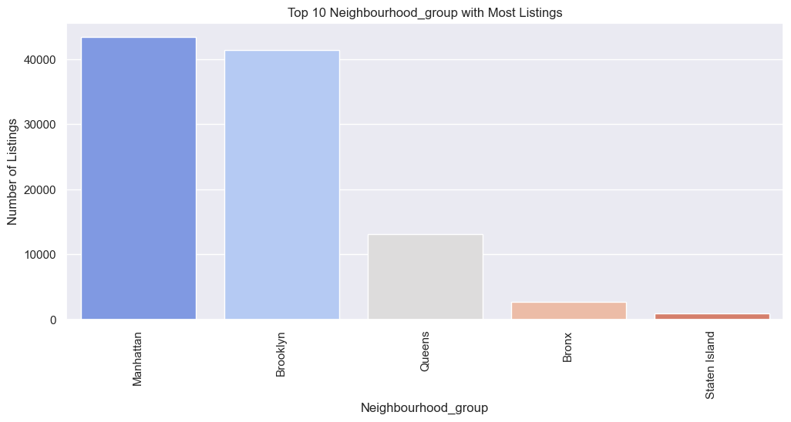
Top 10 Neighborhood Groups with Most Listings
Key Insights from Neighborhood Group Listing Chart :
Dominance of Manhattan and Brooklyn:
Manhattan and Brooklyn have the highest number of listings, with over 40,000 properties each. This highlights their popularity as major Airbnb hubs, likely driven by tourism and business travel.
Significant Drop in Listings in Other Areas:
Queens has a much lower number of listings (around 15,000), indicating it is a secondary choice for visitors, possibly due to fewer tourist attractions or accessibility.
Limited Presence in Bronx and Staten Island:
Bronx and Staten Island have significantly fewer listings, suggesting lower demand for short-term rentals in these areas, potentially because of limited tourist activities or lower accommodation preferences.
Targeted Business Opportunities:
The high listing volume in Manhattan and Brooklyn may indicate strong competition, while areas like Queens or Bronx might present opportunities for budget-friendly or niche accommodation offerings

Slide 4
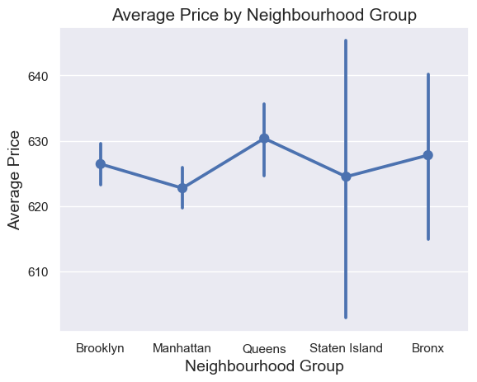
Average Price by Neighborhood Group
Key Insights from Average Price by Neighborhood Group Chart :
Consistent Pricing in Core Areas:
Brooklyn and Manhattan show relatively stable average prices around $620 to $630, indicating a mature and competitive market.
The slight price drop in Manhattan could be due to a higher supply of listings or competitive pricing.
Queens Showing Higher Averages:
Queens has an average price around $630 with noticeable price variations, suggesting a mix of premium and budget-friendly accommodations.
The variation might reflect proximity to airports and tourist attractions in select neighborhoods.
Price Volatility in Staten Island:
Staten Island shows extreme price variability with prices ranging from around $600 to $645. This could indicate occasional high-end rentals or pricing inconsistencies due to low listing volume.
Bronx Pricing Trends:
Bronx has a comparable price to other areas but also shows a wider range of prices. This might be due to a combination of luxury listings and budget accommodations.

Slide 5
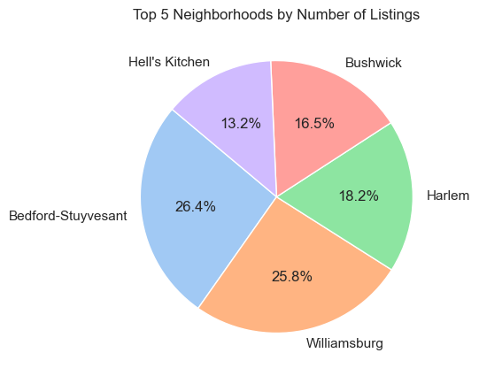
Top 5 Neighborhood by Number of Listings
Key Insights from Top 5 Neighborhoods by Number of Listings Chart for PPT:
Dominance of Bedford-Stuyvesant and Williamsburg:
Bedford-Stuyvesant leads with 26.4% of listings, followed closely by Williamsburg at 25.8%, reflecting these areas' popularity for short-term rentals.
Their thriving hospitality scene and proximity to cultural hubs make them prime choices for Airbnb hosts.
Harlem’s Competitive Presence:
Harlem holds a solid 18.2% share, indicating a significant number of listings. Its mix of historical appeal and increasing tourist interest contributes to this.
Emerging Popularity in Bushwick:
Bushwick accounts for 16.5% of the listings, showcasing its growth as a preferred choice for visitors seeking vibrant art and nightlife experiences.
Lower Listing Share in Hell’s Kitchen:
Despite its central location, Hell’s Kitchen has a relatively lower share (13.2%), possibly due to stricter regulations or higher property costs.

Slide 6
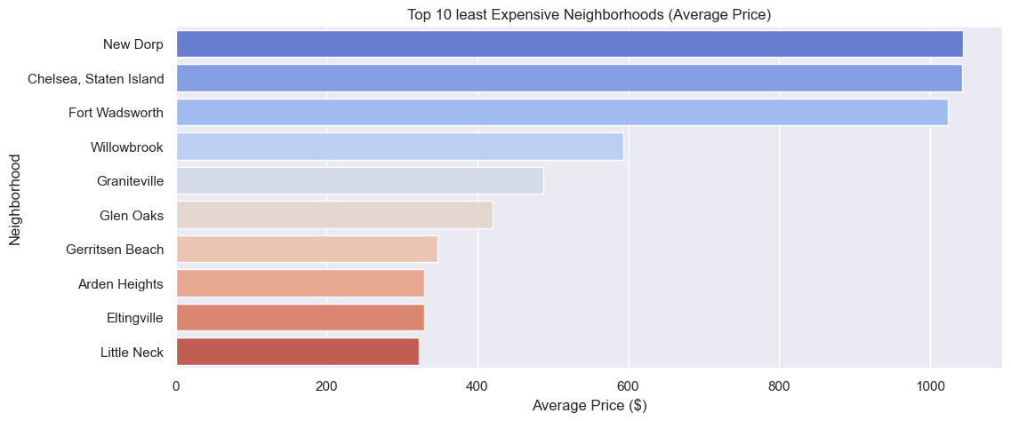
Top 10 Least Expensive Neighborhood (Average Price)
Key Insights from Top 10 Least Expensive Neighborhoods (Average Price) :
Budget-Friendly Options in New Dorp and Chelsea (Staten Island)
New Dorp and Chelsea (Staten Island) offer the most affordable stays, with average prices around $1,000, making them attractive choices for budget-conscious travelers.
Staten Island Dominance in Affordability
Many neighborhoods from Staten Island such as Fort Wadsworth, Willowbrook, and Graniteville rank among the least expensive, positioning the borough as a cost-effective lodging destination.
Willowbrook's Competitive Edge
Willowbrook stands out with a balance of affordability and accessibility, making it a popular choice for travelers seeking both budget stays and convenience.
Queens and Brooklyn Representations
Little Neck (Queens) and Gerritsen Beach (Brooklyn) also appear on the list, providing affordable alternatives compared to premium neighborhoods like Manhattan.

Slide 7
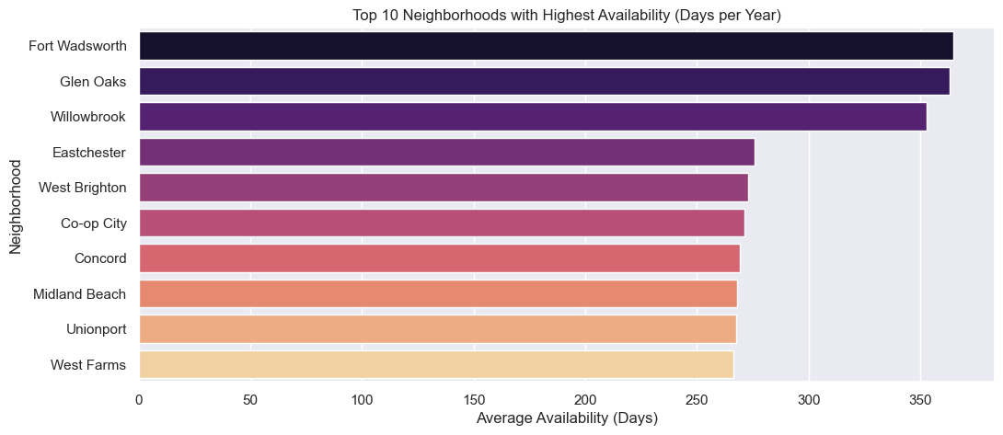
Top 10 Neighborhood with Highest Availability (Days per Year)
Key Insights from Top 10 Neighborhoods with Highest Availability (Days per Year) Chart for PPT:
Fort Wadsworth Leads in Availability
Fort Wadsworth has the highest availability, close to 365 days per year, making it a prime location for long-term stays and flexible booking options.
Staten Island's Strong Presence
Staten Island neighborhoods, including Willowbrook, West Brighton, and Midland Beach, dominate the list, showcasing the borough’s focus on continuous rental availability.
Appeal for Extended Stays
Neighborhoods like Glen Oaks and Eastchester have high availability, making them attractive for long-term business travelers or remote workers seeking stable accommodation options.
Consistent Hosting Practices
High availability suggests consistent hosting practices and possibly a higher proportion of professional hosts in these areas.
Opportunities for Hosts and Travelers
Hosts: Neighborhoods with high availability offer an opportunity to tap into the market for long-term stays or corporate housing.
Travelers: Consider these areas for extended stays or flexible rental options, especially in Staten Island and Bronx.

Slide 8
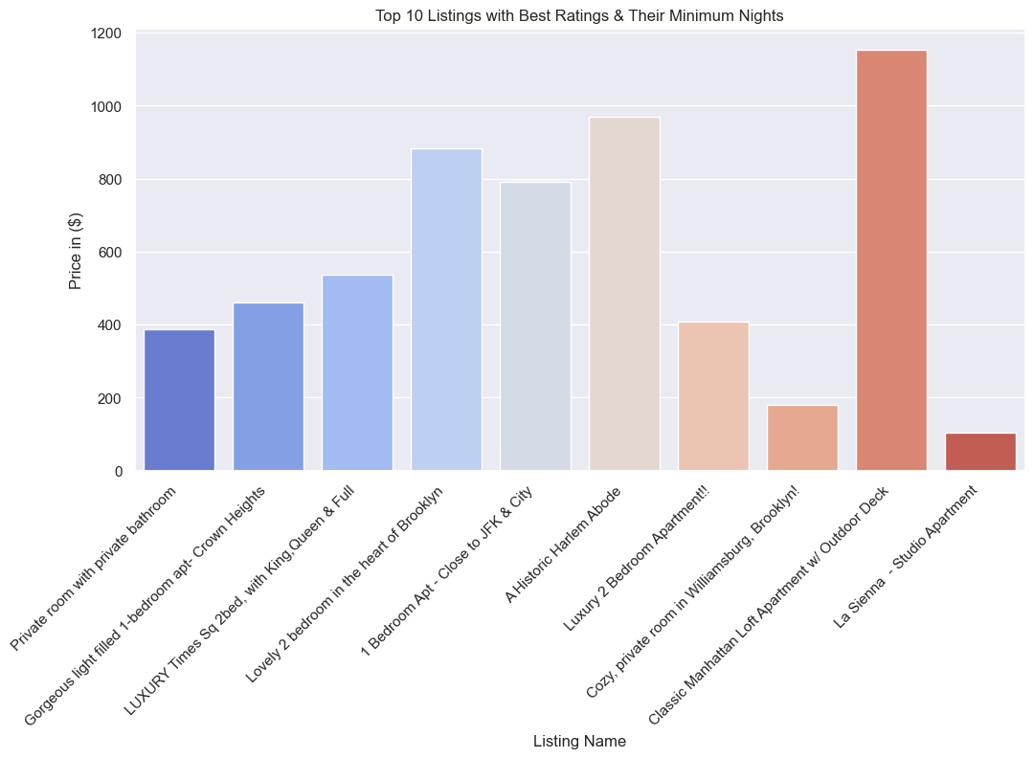
Top 10 Listings with Best Ratings & Their Minimum Nights

Slide 9
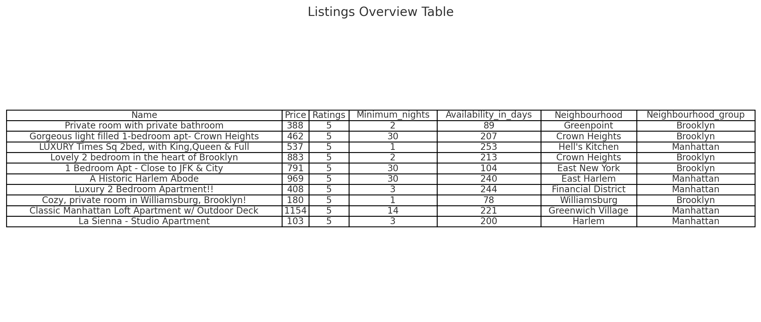
High-Value Listings:
The most expensive listing is the "Classic Manhattan Loft Apartment w/ Outdoor Deck" at around $1,154, reflecting its premium status.
Other high-priced properties include the "A Historic Harlem Abode" and the "Lovely 2 Bedroom in the Heart of Brooklyn", indicating demand for spacious and luxurious accommodations.
Budget Options:
"La Sienna - Studio Apartment" in Harlem is the most affordable at around $103 despite having a 5-star rating, offering great value for travelers.
Neighborhood Trends:
Properties in Brooklyn and Manhattan dominate the chart, indicating these boroughs are popular for highly-rated accommodations.
Crown Heights and Greenpoint in Brooklyn offer excellent 5-star-rated properties with varied pricing, suitable for both budget and luxury travelers.
Minimum Stay Variations:
Some listings require a 30-day minimum stay, particularly the "A Historic Harlem Abode" and "1 Bedroom Apt - Close to JFK & City", indicating a preference for long-term bookings in specific neighborhoods.
On the other hand, "Private room with private bathroom" and "Cozy, private room in Williamsburg" offer short-term stays, making them ideal for tourists.

Slide 10
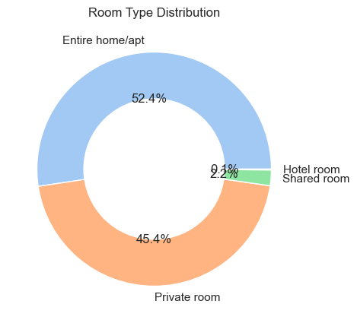
Room Type Distribution
Key Insights from Room Type Distribution Chart
Dominance of Entire Homes/Apartments (52.4%)
The majority of listings are entire homes or apartments, indicating that many hosts cater to travelers looking for full privacy and a home-like experience.
This could be ideal for families, groups, or business travelers seeking a private stay.
Strong Presence of Private Rooms (45.4%)
Nearly half (45.4%) of the listings are private rooms, making them a popular choice for solo travelers or budget-conscious guests.
This suggests a significant portion of hosts are renting out spare rooms rather than entire properties.
Limited Availability of Shared Rooms & Hotel Rooms (2.3%)
Shared rooms (0.1%) are extremely rare, showing that hostel-style accommodations are not a common offering in the area.
Hotel rooms (2.2%) have a minor presence, indicating that short-term rental platforms are primarily driven by private hosts rather than traditional hotels.

Slide 11
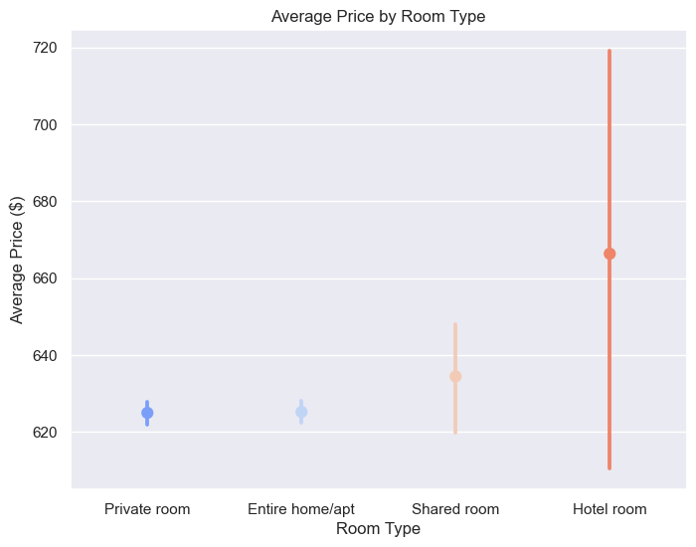
Average Price by Room Type
Key Insights from Average Price by Room Type Chart :
Hotel Rooms Show the Highest Price Variation
Hotel rooms have the highest price variability, ranging from as low as $600 to over $720.
This suggests a wide range of offerings, from budget hotels to luxury stays.
Private Rooms & Entire Apartments Have Stable Pricing
Both Private Rooms (~$620) and Entire Homes/Apartments (~$625) show minimal price variation, indicating consistent pricing trends.
This suggests guests can expect predictable pricing for these room types.
Shared Rooms Are Slightly More Expensive Than Private Rooms
The average price for shared rooms (~$635) is higher than private rooms (~$620).
This could be due to a limited number of shared-room listings, possibly driving prices up.

Slide 12
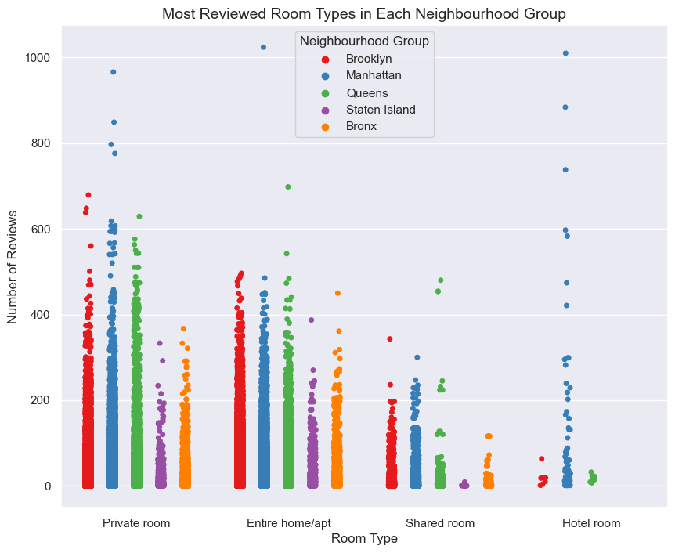
Most Reviewed Room Types in Each Neighborhood Group
Key Insights from Most Reviewed Room Types in Each Neighborhood Group
Private Rooms & Entire Homes/Apartments Have the Highest Number of Reviews
These two room types dominate the market in terms of guest engagement and popularity.
This suggests travelers prefer either privacy or a complete space for their stay.
Brooklyn, Manhattan, and Queens Lead in Reviews
Listings in Brooklyn (red), Manhattan (blue), and Queens (green) receive the most reviews.
Manhattan has listings with the highest review counts (900+ reviews), indicating a strong demand.
Shared Rooms & Hotel Rooms Have Fewer Reviews
Shared rooms receive fewer reviews, likely due to lower availability and demand.
Hotel rooms have some listings with high reviews, but they are far fewer compared to private rooms and entire apartments.
Staten Island & Bronx Have Lower Engagement
Listings in Staten Island (purple) and the Bronx (orange) receive significantly fewer reviews.
This suggests they are less popular areas for short-term stays compared to Brooklyn and Manhattan.

Slide 13
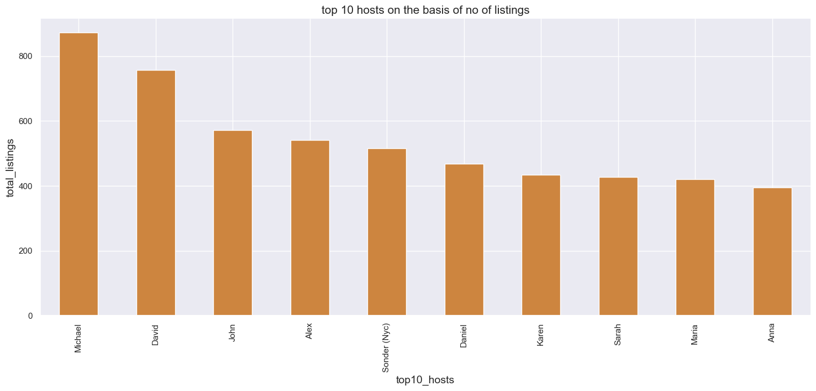
Top 10 hosts on the basis of No of listings
Key Insights from Top 10 Hosts by Number of Listings
Michael and David Lead the Market
Michael has the highest number of listings (850+), followed by David (~780 listings).
These two hosts dominate the market with significantly more listings than others.
Top Hosts Have 400+ Listings Each
All top 10 hosts manage at least 400 listings, indicating they are likely professional property managers rather than individual hosts.
Corporate Hosts Play a Big Role
Sonder (NYC) appears in the list, highlighting the presence of corporate-managed listings.
This suggests that large-scale property management companies contribute significantly to the Airbnb market.
Listings Are Concentrated Among a Few Hosts
The gap between the top 2 hosts (Michael & David) and others suggests a high concentration of listings among a few key players.
Smaller hosts may struggle to compete with these large-scale operators.

Slide 14
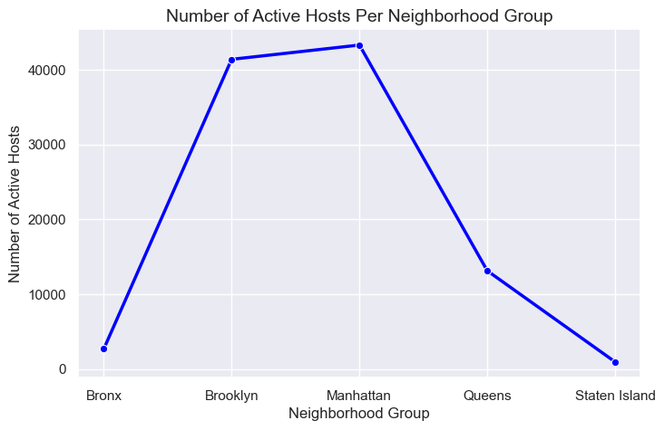
Top 10 hosts on the basis of No of listings
Key Insights: Number of Active Hosts Per Neighborhood Group
Manhattan & Brooklyn Dominate the Market
Manhattan has the highest number of active hosts (~43,000), followed closely by Brooklyn (~41,000).
These two boroughs account for the majority of active hosts, making them the central hubs for Airbnb listings.
Queens Has a Moderate Presence
Queens has significantly fewer hosts (~12,000), much lower than Manhattan and Brooklyn.
This suggests that Queens is not as popular for Airbnb rentals, possibly due to lower tourist demand.
Bronx & Staten Island Have Minimal Airbnb Activity
The Bronx and Staten Island have the lowest number of active hosts, indicating limited Airbnb presence.
This could be due to less tourist attraction, fewer short-term rental properties, or stricter regulations.

Slide 15
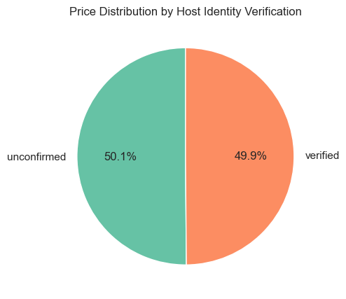
Top 10 hosts on the basis of No of listings
Key Insights: Price Distribution by Host Identity Verification
Balanced Distribution
The price distribution between verified hosts (49.9%) and unconfirmed hosts (50.1%) is almost equal.
This indicates that host verification status does not significantly influence pricing on the platform.
No Significant Price Bias
There is no clear preference for lower or higher prices between verified and unconfirmed hosts.
This suggests that factors like location, room type, and amenities may have a stronger impact on price than host verification alone.
Trust and Verification
While prices are evenly distributed, customers may perceive verified hosts as more trustworthy.
Encouraging host verification can potentially boost customer confidence and lead to more bookings, even without significant price differences.

Slide 16
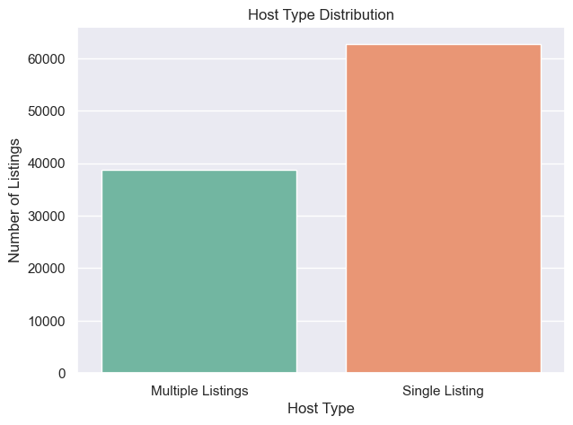
Top 10 hosts on the basis of No of listings
Key Insights: Host Type Distribution
Single Listing Hosts Dominate
The majority of hosts have only one listing, accounting for over 60,000 listings.
This suggests that Airbnb is primarily composed of individual hosts rather than commercial operators.
Multiple Listings Hosts Are Still Significant
While fewer in number, hosts with multiple listings still contribute over 40,000 listings.
This indicates the presence of professional property managers or businesses operating on Airbnb.
Implications for Airbnb Strategy
For hosts: Those with multiple listings may have a competitive edge in scaling their business.
For Airbnb: Balancing support between individual hosts (who ensure a personal experience) and commercial operators (who bring consistency and availability) is essential.

Slide 17
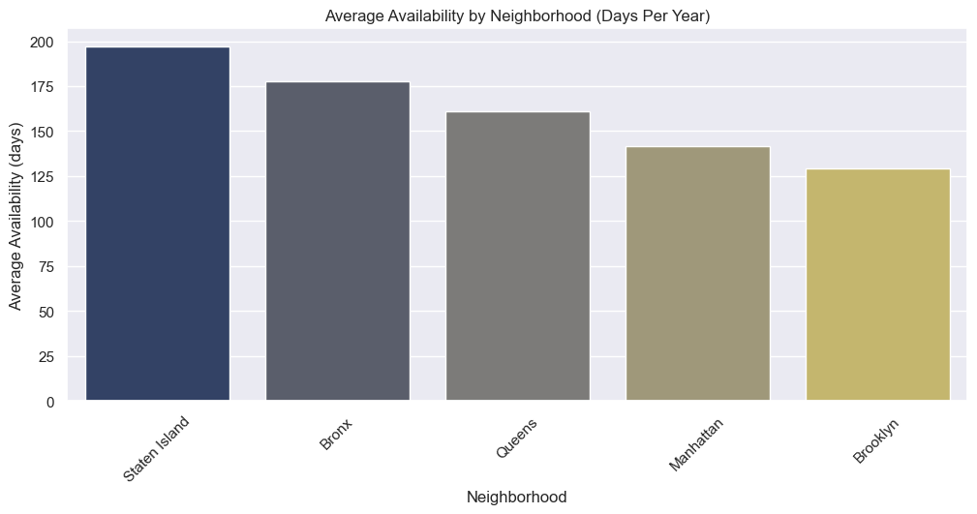
Availability Patterns Across Locations
Key Insights: Average Availability by Neighborhood
Staten Island has the highest availability
Properties in Staten Island are available for rent for nearly 200 days per year, the highest among all neighborhoods.
This suggests lower occupancy rates or fewer booking restrictions in this area.
Bronx and Queens follow closely
Both boroughs have relatively high availability (around 175 and 160 days per year).
This could indicate lower demand, leading to more open days for bookings.
Manhattan and Brooklyn have the lowest availability
Manhattan and Brooklyn show the least availability (under 150 days per year), indicating higher occupancy rates and stronger demand.
These areas are popular among tourists and business travelers, leading to fewer open days.

Slide 18
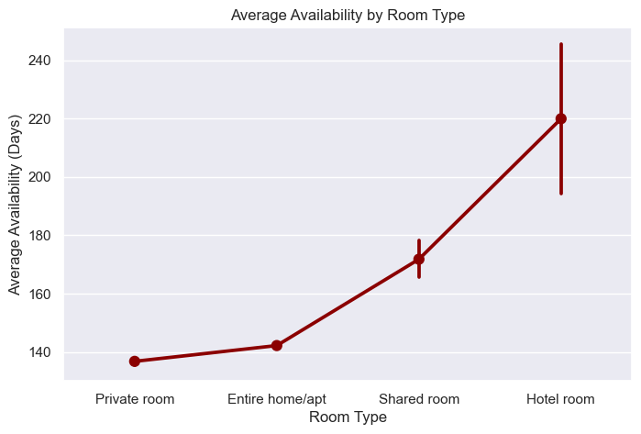
Average Availability by Room Type
Key Insights: Average Availability by Room Type
Hotel Rooms Have the Highest Availability
Hotel rooms show an average availability of around 220 days per year, with some reaching up to 240 days.
This reflects consistent availability due to the professional management and operational scale of hotels.
Shared Rooms Offer Moderate Availability
Shared rooms have an average availability of around 170 days per year.
They tend to have higher availability than private and entire home/apt listings, likely due to lower demand or budget-conscious travelers.
Entire Homes and Private Rooms Show Lower Availability
Entire homes/apartments and private rooms have the lowest availability, averaging around 140 days per year.
These types of properties are often booked for longer stays or may be part-time listings by hosts who also reside there.

Slide 19
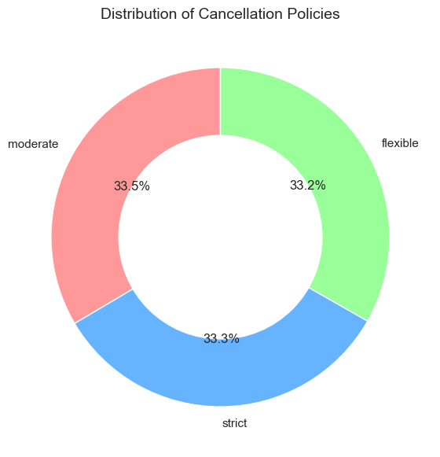
Distribution of Cancellation Policies
Key Insights: Distribution of Cancellation Policies
Balanced Distribution of Policies
The distribution of cancellation policies is nearly equal across the three categories:
Moderate (33.5%)
Strict (33.3%)
Flexible (33.2%)
This suggests that hosts and travelers have diverse preferences when it comes to flexibility.
Slight Preference for Moderate Policies
Moderate cancellation policies are slightly more common, making up 33.5% of the total.
This option may be a middle ground that offers both hosts and guests a fair compromise between flexibility and security.
Opportunities for Hosts and Travelers
Flexible policies (33.2%) are often attractive for last-minute bookings and uncertain travel plans, encouraging more short-term stays.
Strict policies (33.3%) may be preferred by hosts aiming to reduce the risk of cancellations and ensure revenue security.

Slide 20
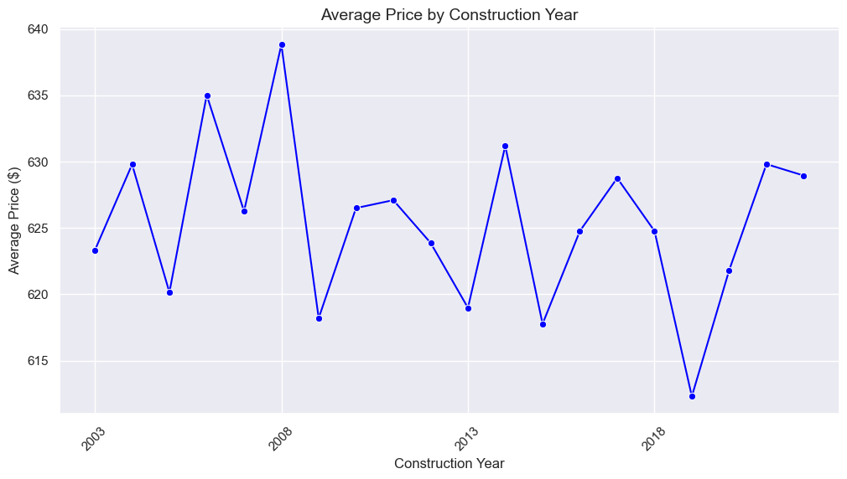
Line Graph for Price Trends by Construction Year
Key Insights: Average Price by Construction Year
Fluctuating Price Trend
The average price shows significant fluctuations across different construction years.
This indicates that factors beyond just the construction year, such as location, amenities, or market demand, likely influence pricing.
Price Peaks Around 2008 and 2013
Notable price spikes are observed in the years 2008 and 2013, with average prices reaching up to $640.
This may be linked to market trends, economic conditions, or increased construction of luxury properties during those periods.
Recent Price Stabilization
In the most recent years, the average price has shown some signs of stabilization around $630.
This could be due to market maturity and increased competition, leading to more consistent pricing.
Low Points in Certain Years
Certain years saw a sharp decline in average prices, possibly indicating the construction of budget accommodations or economic downturns.
For instance, the dip around 2018 may reflect temporary market corrections.

Slide 21
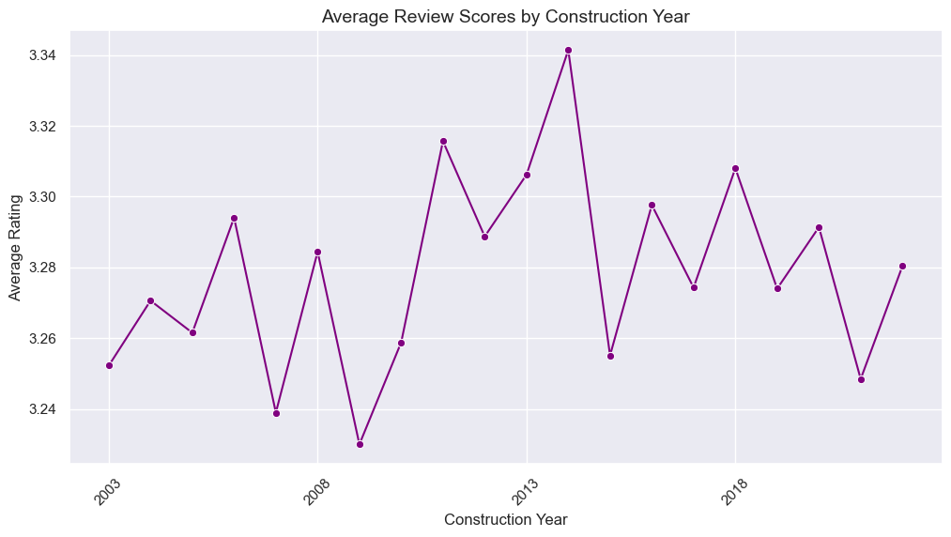
Average Review Scores by Construction Year
Key Insights: Average Review Scores by Construction Year
Stable to Slightly Fluctuating Ratings
Overall, average review scores remain relatively stable between 3.24 to 3.34 across different construction years.
This suggests that construction year alone does not have a significant impact on guest satisfaction.
Peak Rating Around 2013
A noticeable peak in average ratings occurred around 2013, reaching the highest average of approximately 3.34.
This could be attributed to the construction of higher-quality accommodations or better management practices.
Drop After Peak Years
After 2013, the ratings declined and then fluctuated, possibly due to increased competition or aging properties that may not meet guest expectations.
Recent Recovery
While there are some dips in recent years, the overall ratings have shown signs of recovery, indicating potential improvements in service quality or renovations.

